Slide 1

Steganography Hiding Text in Images
Project Report detailing the problem, system design, algorithmic steps, results, conclusion, and future scope of a secure text hiding technique in images using steganography.

Slide 2
Problem Statement
In an era where digital communication is pervasive, protecting sensitive information is critical. Traditional encryption can reveal the presence of hidden data, potentially attracting malicious attention.
The core problem is...
Ensuring information confidentiality during digital transmission.
Embedding secret text undetectably into common digital media such as images.
Preventing degradation or suspicion by retaining the original media's visual integrity.
This project explores the challenge of embedding textual data imperceptibly within images while maintaining image quality and security.

Slide 3
System Development Approach (Technology Used)
The project employs a combination of powerful yet accessible technologies suitable for image processing and data handling:
Programming Language: Python - chosen for rapid development and rich library ecosystem.
Image Processing: Pillow (PIL) library to load, manipulate, and save images.
Data Handling: NumPy for efficient pixel array manipulation.
Interface (optional): Tkinter for a minimal GUI allowing embedding and extraction operations.
The Least Significant Bit (LSB) technique is applied to embed data bits into the image pixels with minimal perceptual impact.

Slide 4
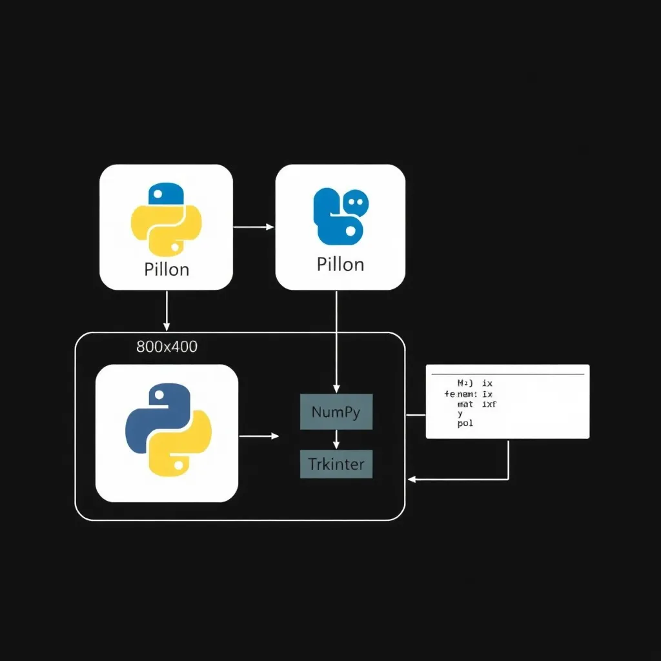

Slide 5
Algorithm & Deployment (Step-by-Step Procedure)
Embedding Procedure
Input Preparation: Load the cover image and convert the secret text message to binary representation.
Embedding Data: Iterate pixel-wise through the image's RGB color data.
Replace the least significant bit of each pixel’s color component with bits from the secret message.
Include a predefined delimiter or message length header for extraction reference.
Output: Save the modified image (stego image) with hidden text embedded.
Extraction Procedure
Load Stego Image: Read the image used to hide data.
Bit Extraction: Traverse the pixels, extract the least significant bits from color components in order.
Message Reconstruction: Combine bits until the delimiter or length is reached, reconstructing the original text.

Slide 6

Visual representation of the Least Significant Bit (LSB) embedding process changing pixel values to hide binary data.

Slide 7
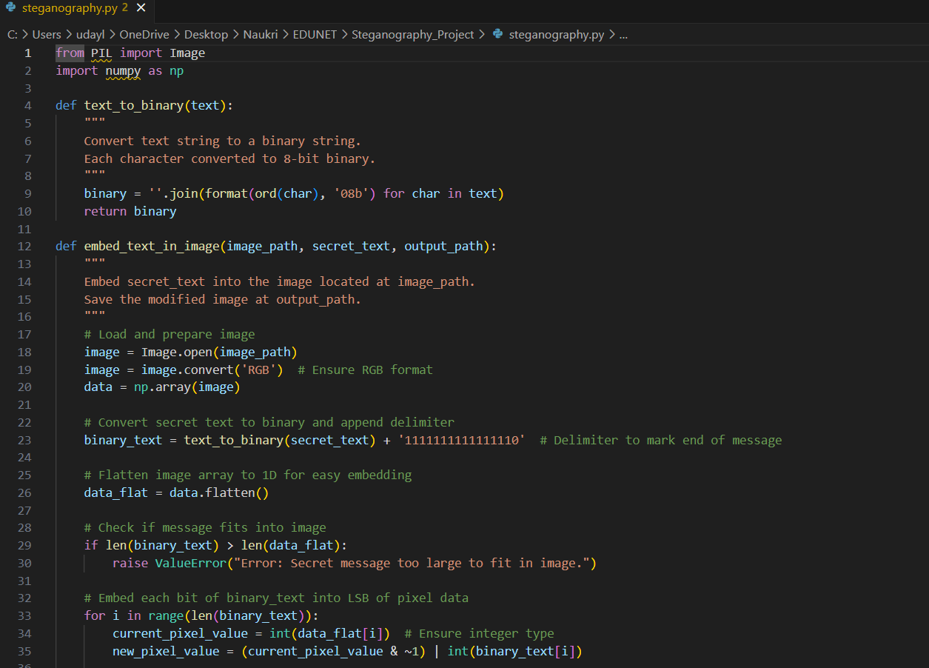
Result

Slide 8
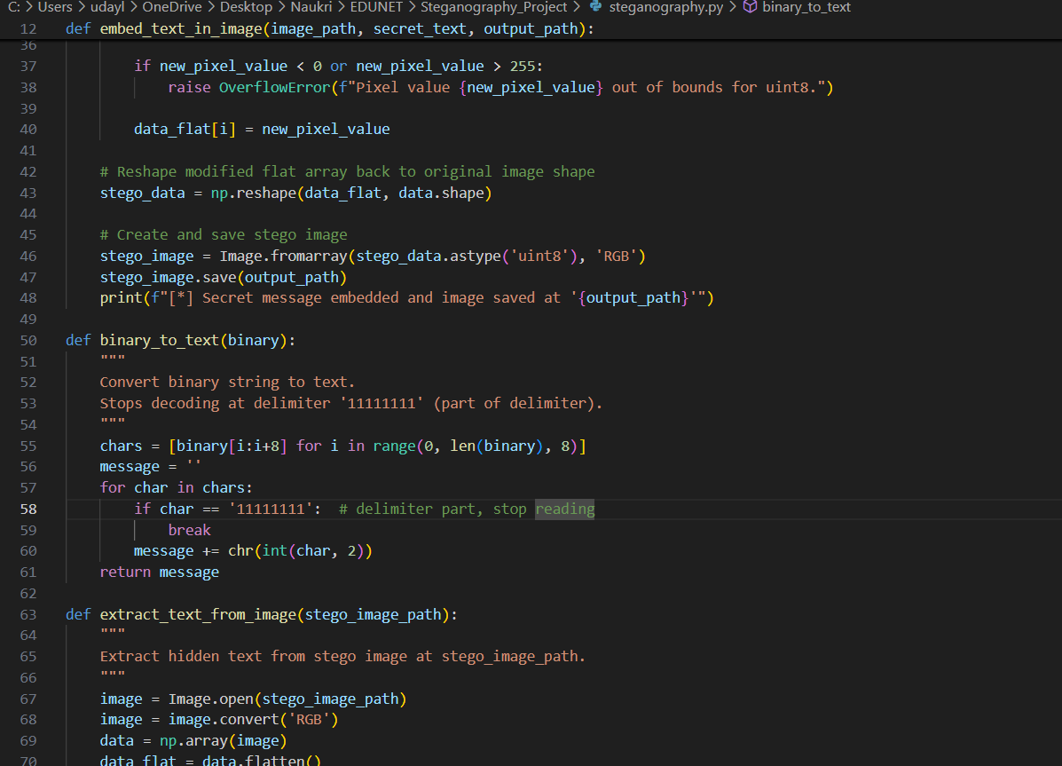
Result

Slide 9
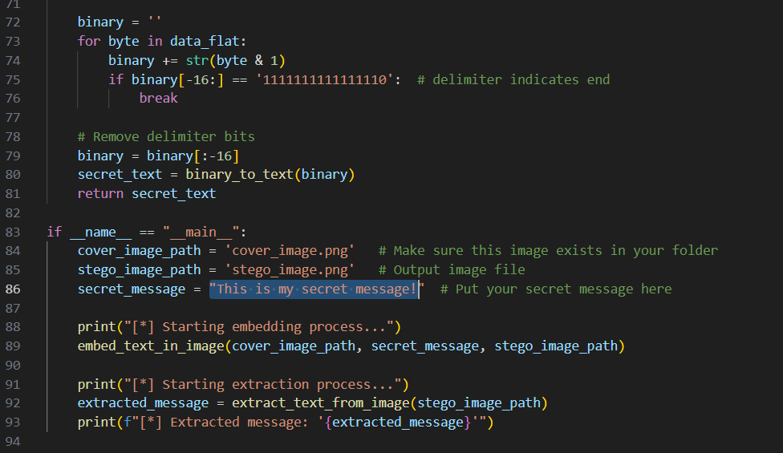
Result

Slide 10
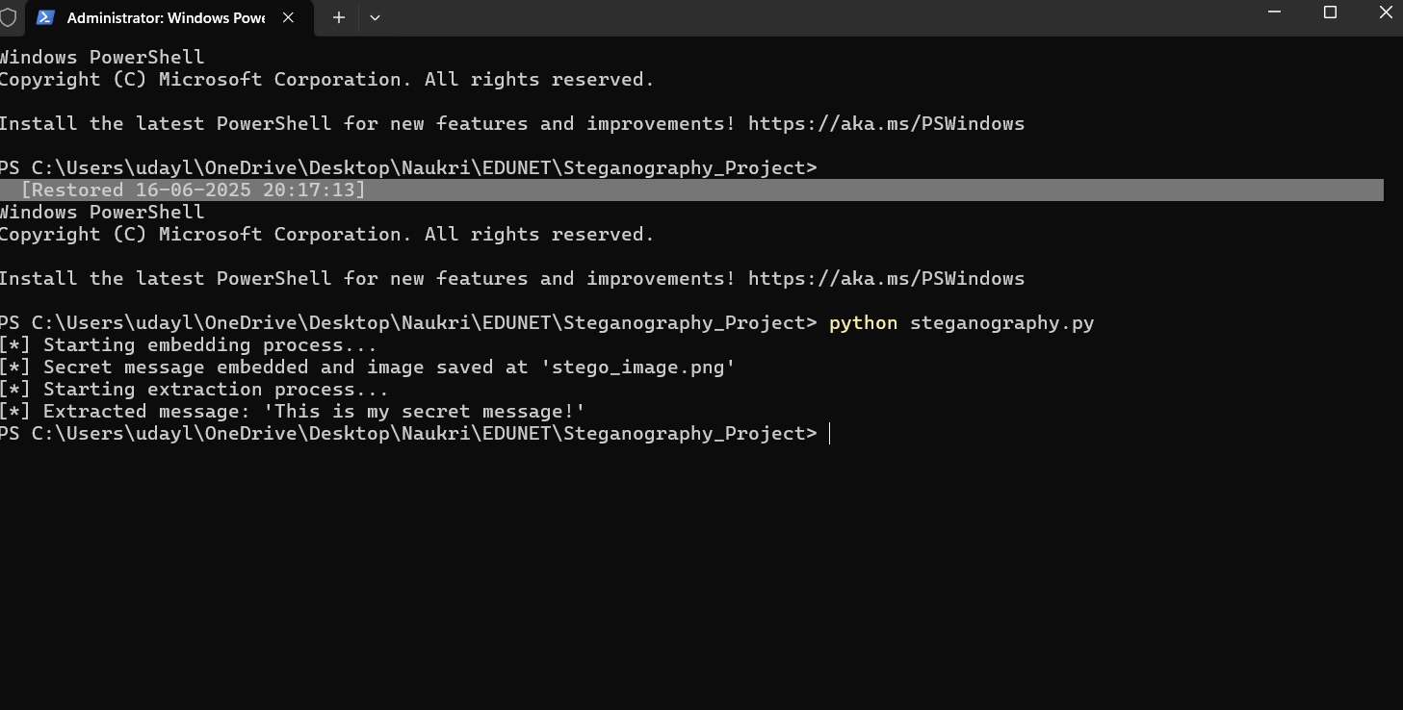
Result

Slide 11


Result
Cover_image.png
Stego_image.png
https://github.com/udayleo1985/Steganography_Project.git

Slide 12
Information is power, but only if it remains hidden

